Slide 1
Natural Language Processing: Spacy Tutorial
Dr. Hafiz Khan
mkhan74@Kennesaw.edu
Computer Science, Kennesaw State University
https://ahafizk.github.io/

Slide 2
Outline
Introduction to Spacy
Spacy V2 used in this tutorial
Rule-based matching
Large-scale data analysis
Processing pipeline
Scaling and performance

Slide 3
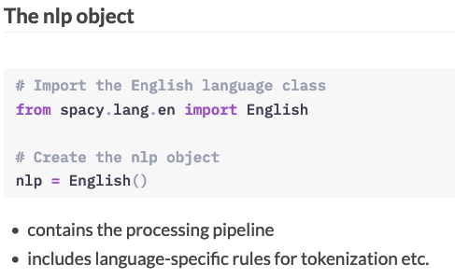
Introduction to Spacy

Slide 4
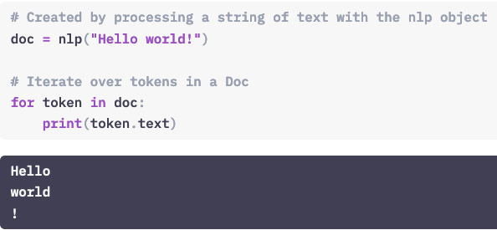
The Doc object
When you process a text with the nlp object, spaCy creates a Doc object – short for "document".
The Doc lets you access information about the text in a structured way, and no information is lost.
The Doc behaves like a normal Python sequence by the way and lets you iterate over its tokens, or get a token by its index. But more on that later!

Slide 5
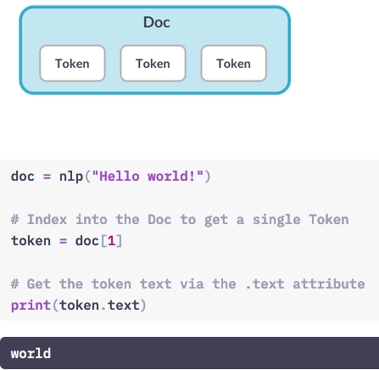
The Token object
Token objects represent the tokens in a document – for example, a word or a punctuation character.
To get a token at a specific position, you can index into the doc.
Token objects also provide various attributes that let you access more information about the tokens. For example, the .text attribute returns the verbatim token text.

Slide 6
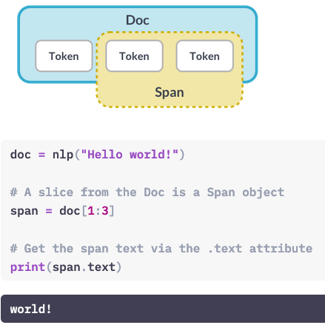
The Span object
A Span object is a slice of the document consisting of one or more tokens. It's only a view of the Doc and doesn't contain any data itself.
To create a span, you can use Python's slice notation. For example, 1:3 will create a slice starting from the token at position 1, up to – but not including! – the token at position 3.

Slide 7
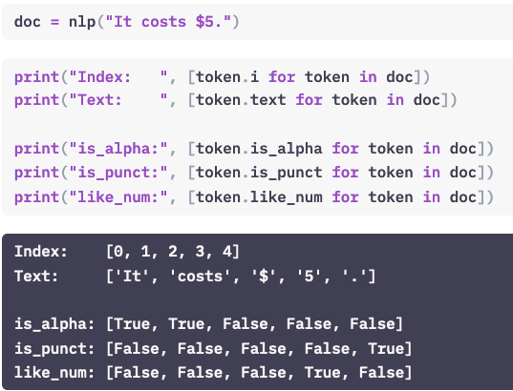
Lexical Attributes
Here you can see some of the available token attributes:
i is the index of the token within the parent document.
text returns the token text.
is_alpha, is_punct and like_num return boolean values indicating whether the token consists of alphabetic characters, whether it's punctuation or whether it resembles a number. For example, a token "10" – one, zero – or the word "ten" – T, E, N.
These attributes are also called lexical attributes: they refer to the entry in the vocabulary and don't depend on the token's context.

Slide 8
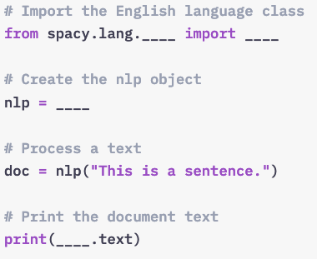
Exercise

Slide 9
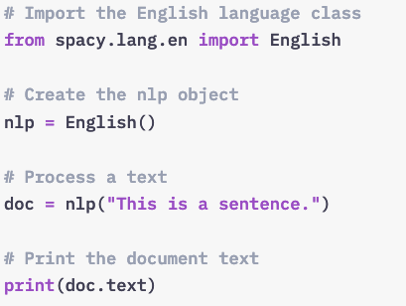
Solution

Slide 10
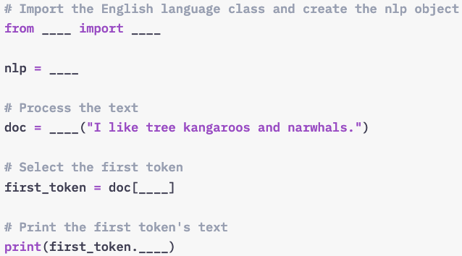
Exercise: Document, Span and token
When you call nlp on a string, spaCy first tokenizes the text and creates a document object. In this exercise, you’ll learn more about the Doc, as well as its views Token and Span.
Step 1:
Import the English language class and create the nlp object.
Process the text and instantiate a Doc object in the variable doc.
Select the first token of the Doc and print its text.

Slide 11
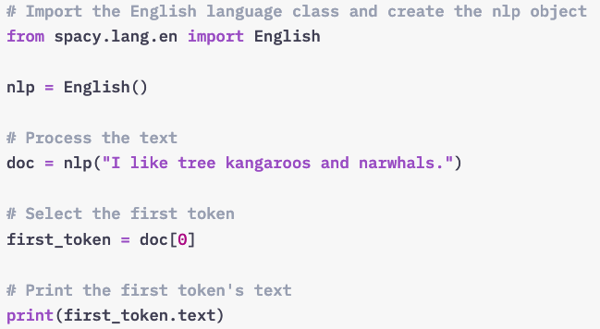
Exercise: Document, Span and token - Solution

Slide 12
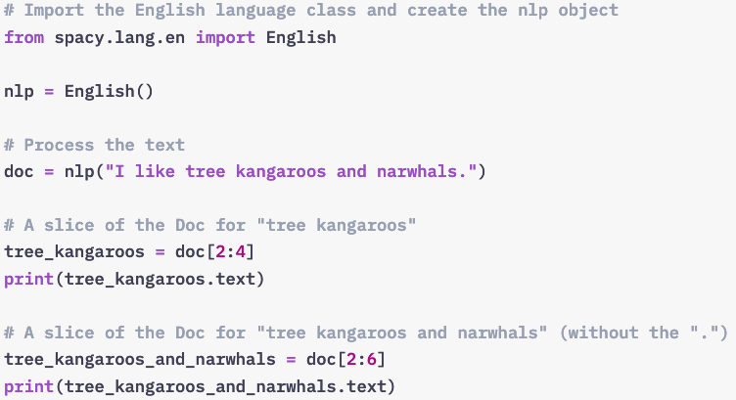
Exercise-2: Document, Span and token
When you call nlp on a string, spaCy first tokenizes the text and creates a document object. In this exercise, you’ll learn more about the Doc, as well as its views Token and Span.
Step 2:
Import the English language class and create the nlp object.
Process the text and instantiate a Doc object in the variable doc.
Create a slice of the Doc for the tokens “tree kangaroos” and “tree kangaroos and narwhals”.

Slide 13
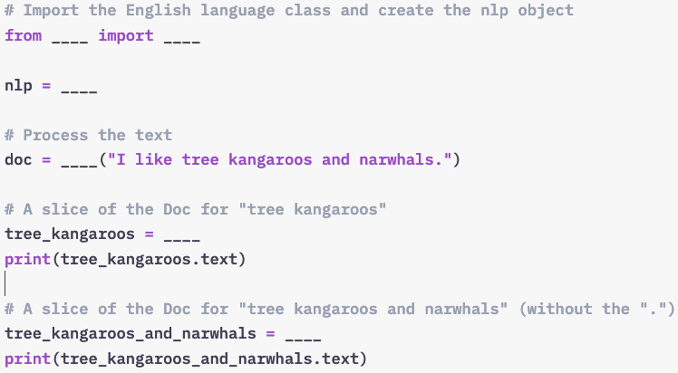
Exercise-2: Document, Span and token -- Solution
When you call nlp on a string, spaCy first tokenizes the text and creates a document object. In this exercise, you’ll learn more about the Doc, as well as its views Token and Span.
Step 2:
Import the English language class and create the nlp object.
Process the text and instantiate a Doc object in the variable doc.
Create a slice of the Doc for the tokens “tree kangaroos” and “tree kangaroos and narwhals”.

Slide 14
Lexical Attribute: Example
In this example, you’ll use spaCy’s Doc and Token objects, and lexical attributes to find percentages in a text.
You’ll be looking for two subsequent tokens: a number and a percent sign.
Use the like_num token attribute to check whether a token in the doc resembles a number.
Get the token following the current token in the document.
The index of the next token in the doc is token.i + 1.
Check whether the next token’s text attribute is a percent sign ”%“.

Slide 15
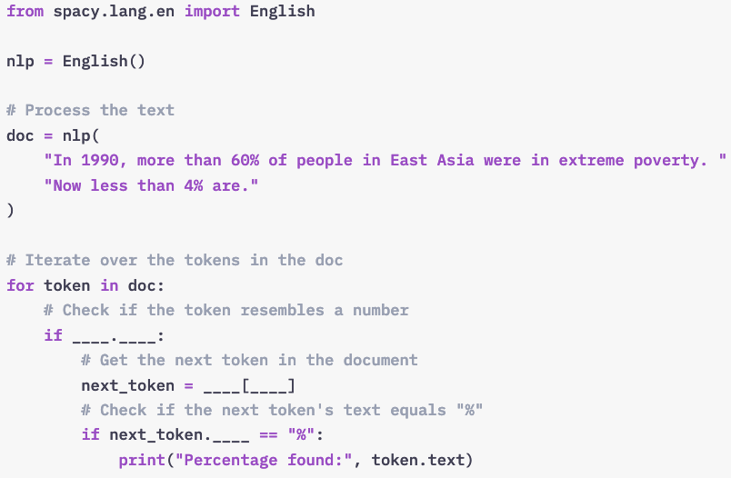
Lexical attribute: Exercise

Slide 16
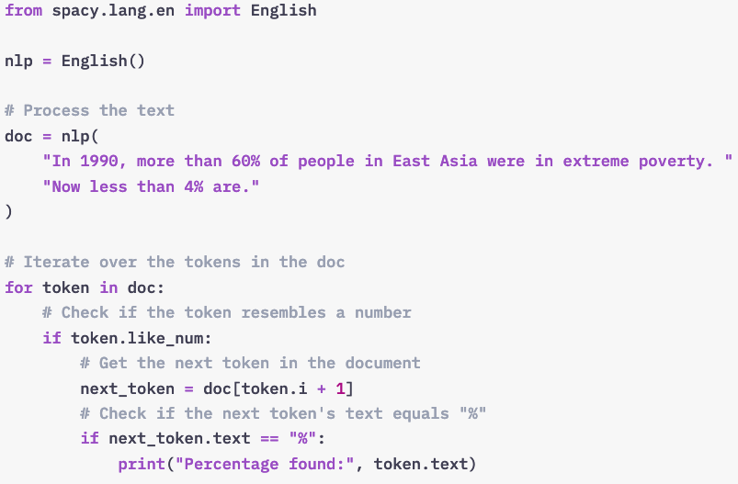
Lexical attribute: Solution

Slide 17
Statistical Models

Slide 18
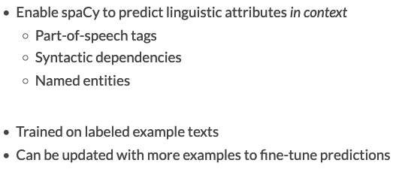
What are statistical models?
https://spacy.io/usage/models

Slide 19
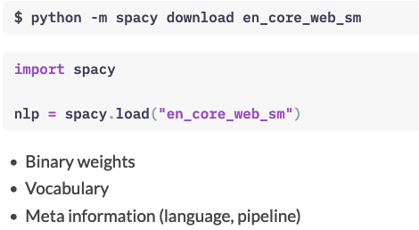
Model Packages
spaCy provides a number of pre-trained model packages you can download using the spacy download command. For example, the "en_core_web_sm" package is a small English model that supports all core capabilities and is trained on web text.
The spacy.load method loads a model package by name and returns an nlp object.
The package provides the binary weights that enable spaCy to make predictions.
It also includes the vocabulary, and meta information to tell spaCy which language class to use and how to configure the processing pipeline.

Slide 20
Loading Models
The models we’re using in this course are already pre-installed. For more details on spaCy’s statistical models and how to install them on your machine, see the documentation.
Use spacy.load to load the small English model "en_core_web_sm".
Process the text and print the document text.
https://spacy.io/usage/models

Slide 21
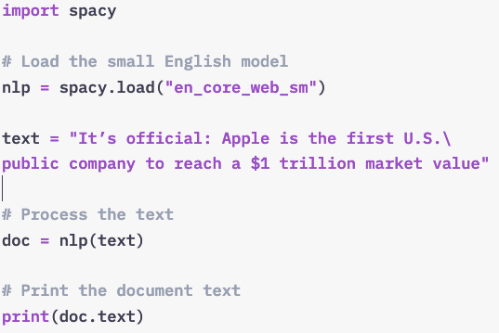
Loading Models

Slide 22
Predicting Linguistic Annotations
spaCy’s pre-trained model packages and see its predictions in action.
To find out what a tag or label means,
you can call spacy.explain in the loop.
For example: spacy.explain("PROPN") or spacy.explain("GPE").

Slide 23
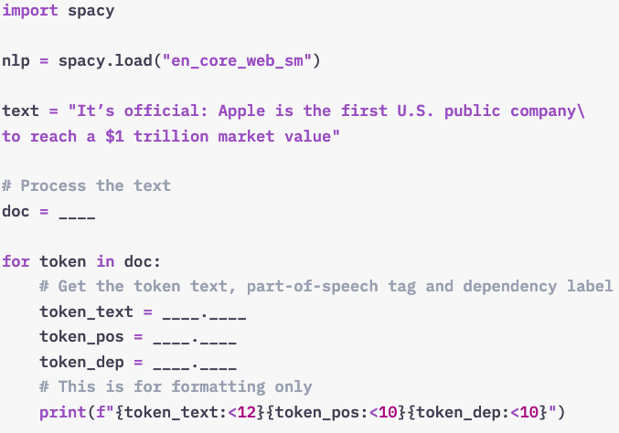
Exercise: Predicting Linguistic Annotations
Task:
Process the text with the nlp object and create a doc.
For each token, print the token text, the token’s .pos_ (part-of-speech tag) and the token’s .dep_ (dependency label).

Slide 24
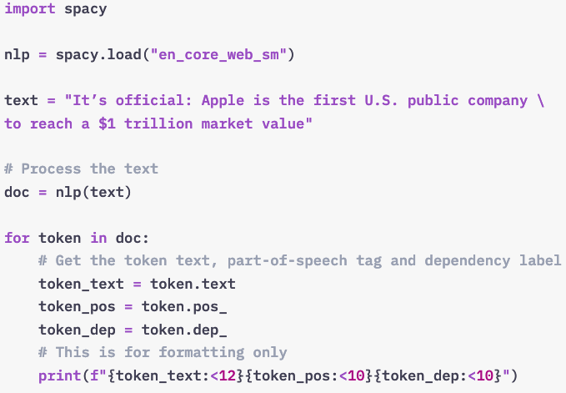
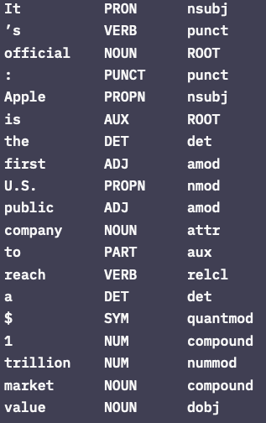
Solution: Predicting Linguistic Annotations

Slide 25
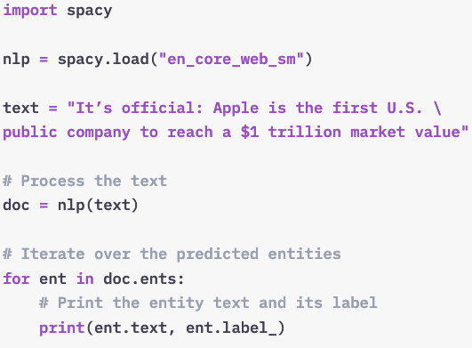
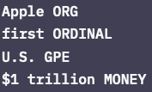
Exercise: Predicting Linguistic Annotations
Task 2:
Process the text and create a doc object.
Iterate over the doc.ents and print the entity text and label_ attribute.

Slide 26
Predicting Name Entities in Context
Models are statistical and not always right. Whether their predictions are correct depends on the training data and the text you’re processing. Let’s take a look at an example.
Process the text with the nlp object.
Iterate over the entities and print the entity text and label.
Looks like the model didn’t predict “iPhone X”. Create a span for those tokens manually.

Slide 27
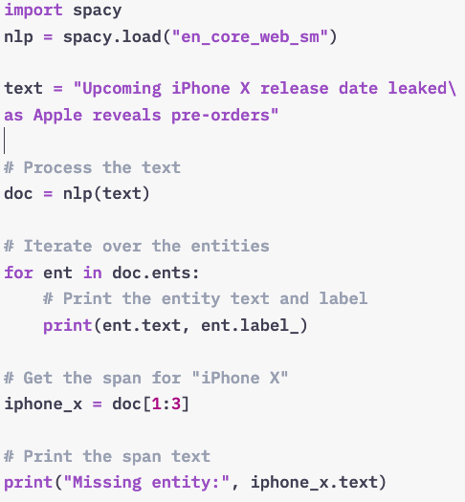
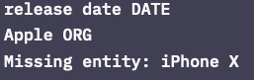
Predicting Name Entities in Context

Slide 28
Rule-based matching

Slide 29
Why not just regular expressions?
Compared to regular expressions, the matcher works with Doc and Token objects instead of only strings.
It's also more flexible: you can search for texts but also other lexical attributes.
You can even write rules that use the model's predictions.
For example, find the word "duck" only if it's a verb, not a noun.

Slide 30
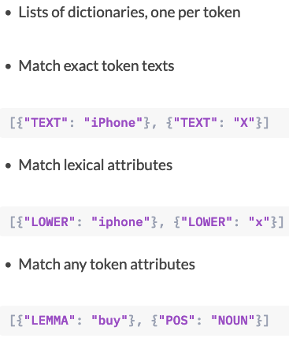
Match patterns

Slide 31
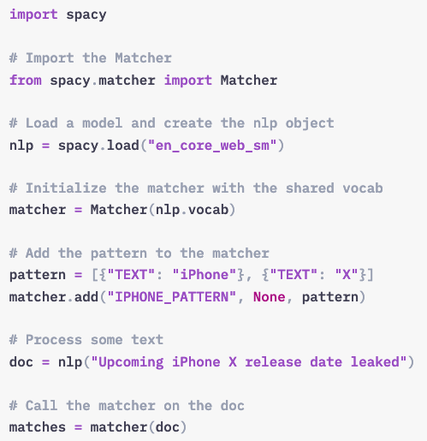
Match Patterns
To use a pattern, we first import the matcher from spacy.matcher.
We also load a model and create the nlp object.
The matcher is initialized with the shared vocabulary, nlp.vocab. You'll learn more about this later – for now, just remember to always pass it in.
The matcher.add method lets you add a pattern. The first argument is a unique ID to identify which pattern was matched. The second argument is an optional callback. We don't need one here, so we set it to None. The third argument is the pattern.
To match the pattern on a text, we can call the matcher on any doc.
This will return the matches.

Slide 32
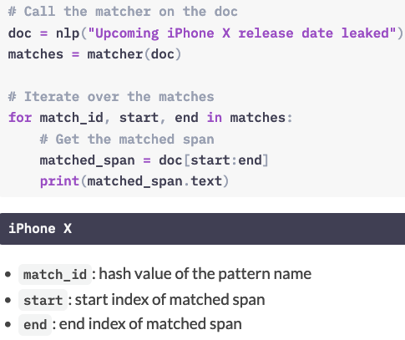
Match Patterns
When you call the matcher on a doc, it returns a list of tuples.
Each tuple consists of three values: the match ID, the start index and the end index of the matched span.
This means we can iterate over the matches and create a Span object: a slice of the doc at the start and end index.

Slide 33
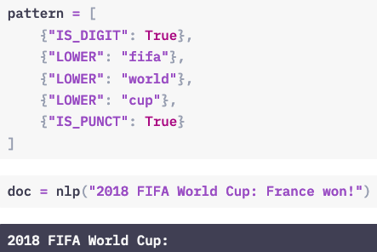
Matching lexical attributes
Here's an example of a more complex pattern using lexical attributes.
We're looking for five tokens:
A token consisting of only digits.
Three case-insensitive tokens for "fifa", "world" and "cup".
And a token that consists of punctuation.
The pattern matches the tokens "2018 FIFA World Cup:".

Slide 34
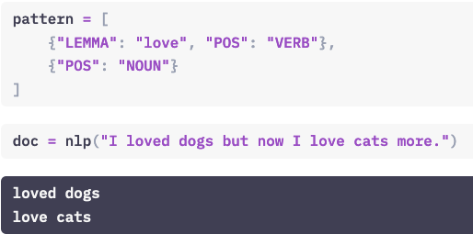
Matching other token attributes
In this example, we're looking for two tokens:
A verb with the lemma "love", followed by a noun.
This pattern will match "loved dogs" and "love cats".

Slide 35
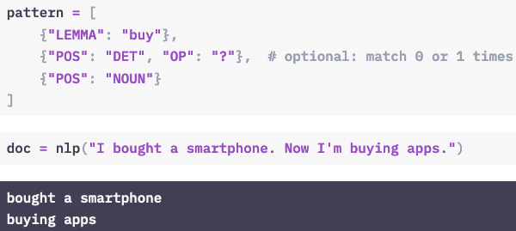
Using operators and quantifiers (1)
Operators and quantifiers let you define how often a token should be matched. They can be added using the "OP" key.
Here, the "?" operator makes the determiner token optional, so it will match a token with the lemma "buy", an optional article and a noun.

Slide 36
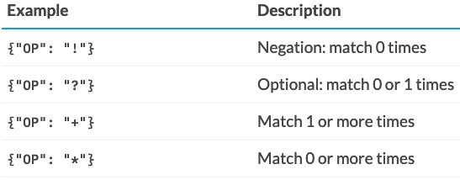
Using operators and quantifiers (2)
"OP" can have one of four values:
An "!" negates the token, so it's matched 0 times.
A "?" makes the token optional, and matches it 0 or 1 times.
A "+" matches a token 1 or more times.
And finally, an "*" matches 0 or more times.
Operators can make your patterns a lot more powerful, but they also add more complexity – so use them wisely.

Slide 37
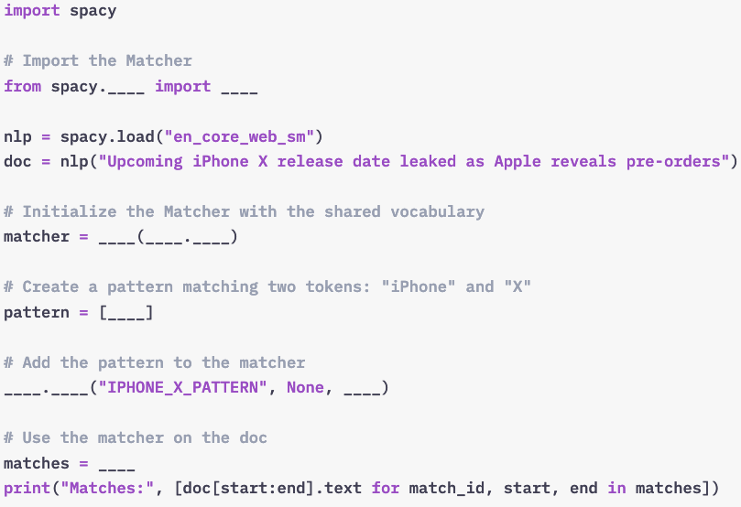
Exercise: Using the Matcher
You’ll be using the example from the previous exercise and write a pattern that can match the phrase “iPhone X” in the text.
Steps:
Import the Matcher from spacy.matcher.
Initialize it with the nlp object’s shared vocab.
Create a pattern that matches the "TEXT" values of two tokens: "iPhone" and "X".
Use the matcher.add method to add the pattern to the matcher.
Call the matcher on the doc and store the result in the variable matches.
Iterate over the matches and get the matched span from the start to the end index.

Slide 38
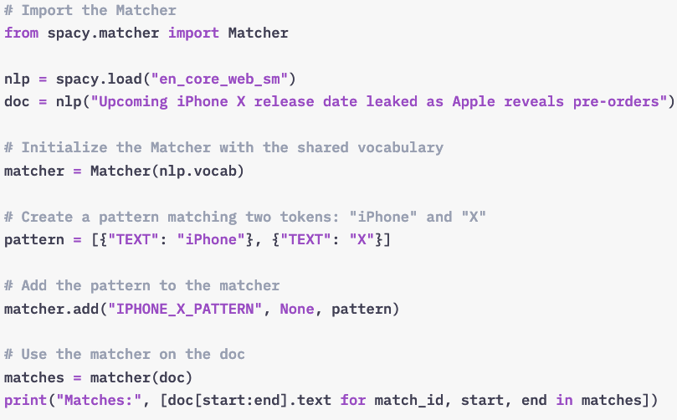
Solution: Using the Matcher

Slide 39
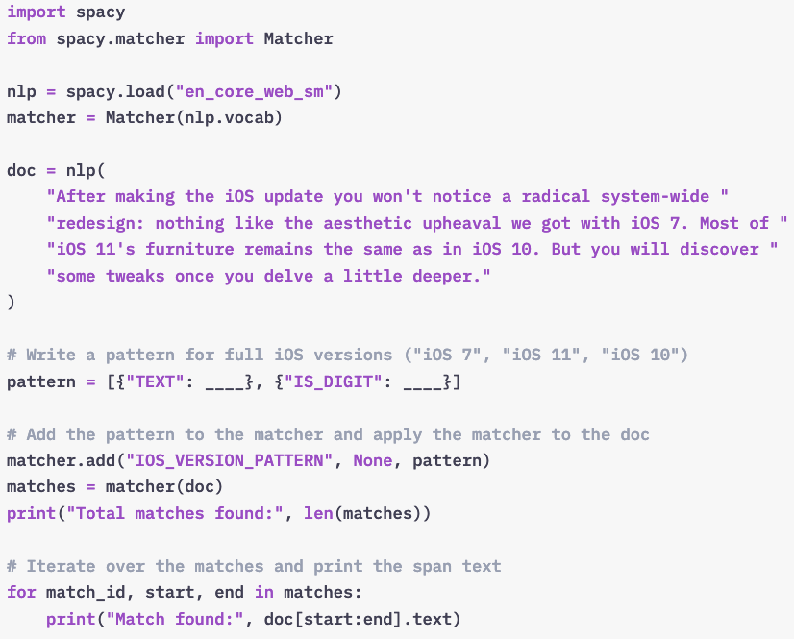
Writing Match Patterns
Task: Write one pattern that only matches mentions of the full iOS versions: “iOS 7”, “iOS 11” and “iOS 10”.

Slide 40

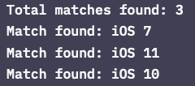
Solution: Writing Match Patterns

Slide 41
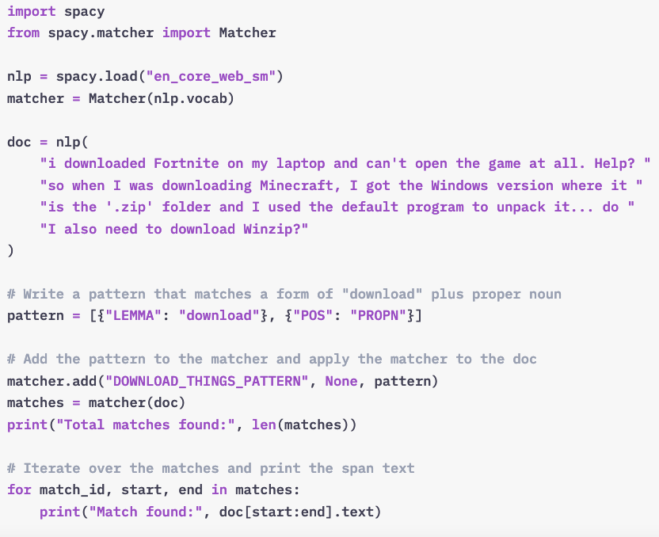
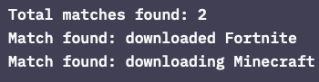
Exercise 2: Writing Match Patterns
Write one pattern that only matches forms of “download” (tokens with the lemma “download”), followed by a token with the part-of-speech tag "PROPN" (proper noun).

Slide 42
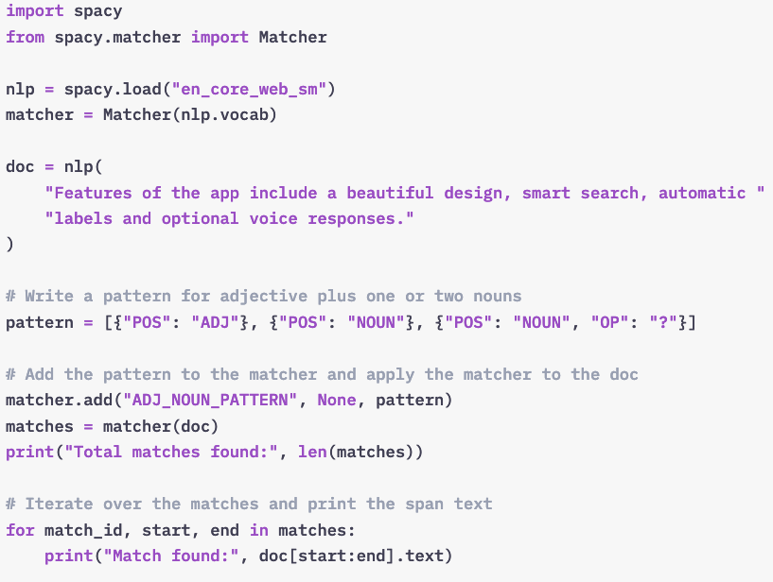
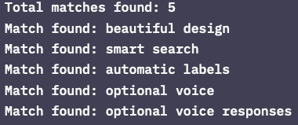
Exercise 3: Writing Match Patterns

Slide 43
Large-scale data analysis with spaCy

Slide 44
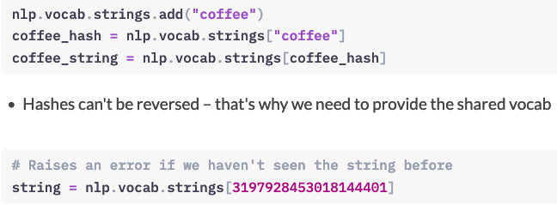
Shared vocab and string store (1)
Vocab: stores data shared across multiple documents
To save memory, spaCy encodes all strings to hash values
Strings are only stored once in the StringStore via nlp.vocab.strings
String store: lookup table in both directions

Slide 45
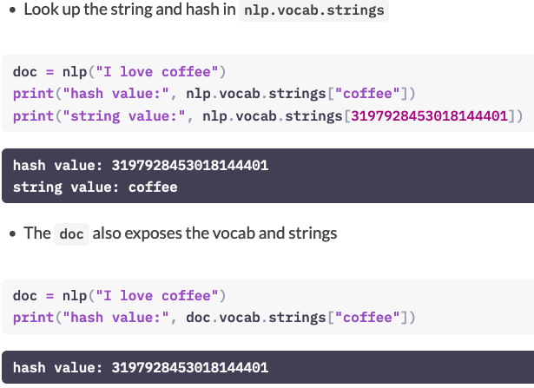
Shared vocab and string store (2)

Slide 46
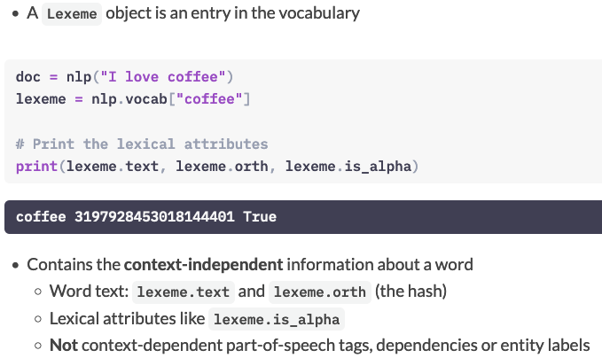
Lexemes: entries in the vocabulary

Slide 47
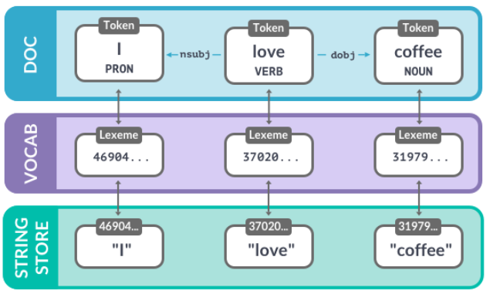
Vocab, hashes and lexemes
The Doc contains words in context – in this case, the tokens "I", "love" and "coffee" with their part-of-speech tags and dependencies.
Each token refers to a lexeme, which knows the word's hash ID. To get the string representation of the word, spaCy looks up the hash in the string store.

Slide 48
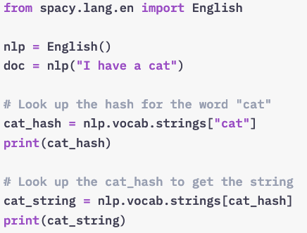
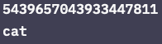
String to hashes
Look up the string “cat” in nlp.vocab.strings to get the hash.
Look up the hash to get back the string.

Slide 49
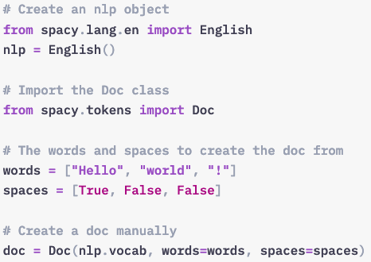
Data Structure (2):Doc, Span, and Token
The Doc is one of the central data structures in spaCy. It's created automatically when you process a text with the nlp object. But you can also instantiate the class manually.
After creating the nlp object, we can import the Doc class from spacy.tokens.
Here we're creating a doc from three words. The spaces are a list of boolean values indicating whether the word is followed by a space. Every token includes that information – even the last one!
The Doc class takes three arguments: the shared vocab, the words and the spaces.

Slide 50
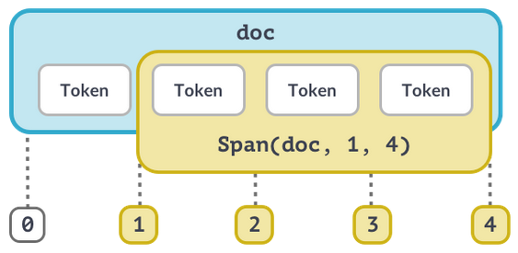
The Span object (1)
A Span is a slice of a doc consisting of one or more tokens. The Span takes at least three arguments: the doc it refers to, and the start and end index of the span. Remember that the end index is exclusive!

Slide 51
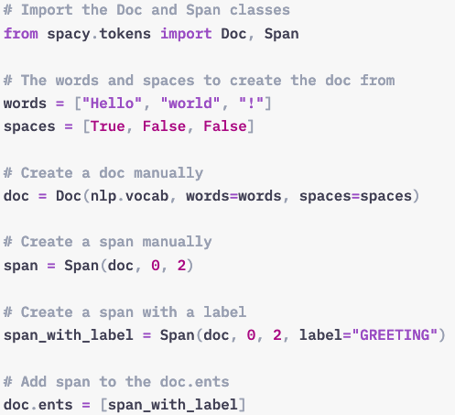
The Span object (2)
To create a Span manually, we can also import the class from spacy.tokens. We can then instantiate it with the doc and the span's start and end index, and an optional label argument.
The doc.ents are writable, so we can add entities manually by overwriting it with a list of spans.

Slide 52
Best practices
Doc and Span are very powerful and hold references and relationships of words and sentences
Convert result to strings as late as possible
Use token attributes if available – for example, token.i for the token index
Don't forget to pass in the shared vocab

Slide 53
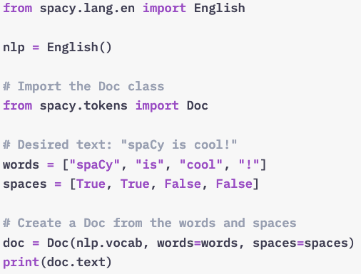
Let’s create some Doc objects from scratch!
Import the Doc from spacy.tokens.
Create a Doc from the words and spaces. Don’t forget to pass in the vocab!

Slide 54
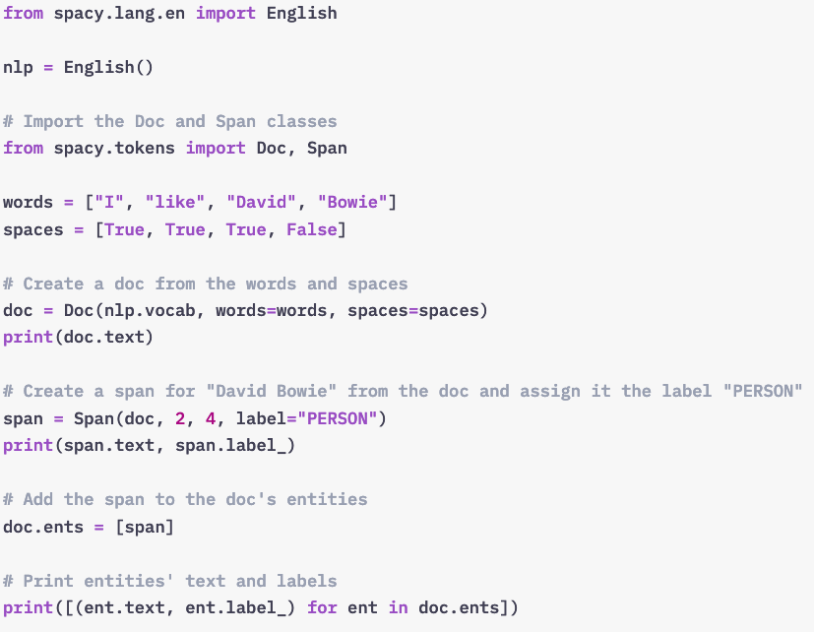
Docs, Spans and entities from scratch
In this exercise, you’ll create the Doc and Span objects manually, and update the named entities – just like spaCy does behind the scenes. A shared nlp object has already been created.
Import the Doc and Span classes from spacy.tokens.
Use the Doc class directly to create a doc from the words and spaces.
Create a Span for “David Bowie” from the doc and assign it the label "PERSON".
Overwrite the doc.ents with a list of one entity, the “David Bowie” span.

Slide 55
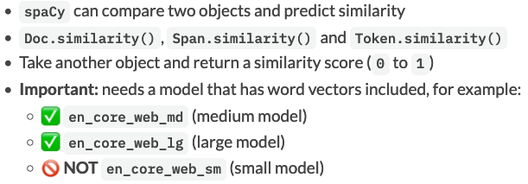
Word vectors and semantic similarity
Comparing semantic similarity

Slide 56

Similarity examples (1)
Here's an example. Let's say we want to find out whether two documents are similar.
First, we load the medium English model, "en_core_web_md".
We can then create two doc objects and use the first doc's similarity method to compare it to the second.
Here, a fairly high similarity score of 0.86 is predicted for "I like fast food" and "I like pizza".
The same works for tokens.
According to the word vectors, the tokens "pizza" and "pasta" are kind of similar, and receive a score of 0.7.

Slide 57

Similarity examples (2)
You can also use the similarity methods to compare different types of objects.
For example, a document and a token.
Here, the similarity score is pretty low and the two objects are considered fairly dissimilar.
Here's another example comparing a span – "pizza and pasta" – to a document about McDonalds.
The score returned here is 0.61, so it's determined to be kind of similar.

Slide 58
How does spaCy predict similarity?
Similarity is determined using word vectors
Multi-dimensional meaning representations of words
Generated using an algorithm like Word2Vec and lots of text
Can be added to spaCy's statistical models
Default: cosine similarity, but can be adjusted
Doc and Span vectors default to average of token vectors
Short phrases are better than long documents with many irrelevant words

Slide 59

Word vectors in spaCy
To give you an idea of what those vectors look like, here's an example.
First, we load the medium model again, which ships with word vectors.
Next, we can process a text and look up a token's vector using the .vector attribute.
The result is a 300-dimensional vector of the word "banana".

Slide 60

Similarity depends on the application context

Slide 61

Inspecting Word Vectors
In this exercise, you’ll use a larger English model, which includes around 20.000 word vectors. The model is already pre-installed.
Load the medium "en_core_web_md" model with word vectors.
Print the vector for "bananas" using the token.vector attribute.

Slide 62

Comparing Similarity
Use the doc.similarity method to compare doc1 to doc2 and print the result.
Use the token.similarity method to compare token1 to token2 and print the result.
Create spans for “great restaurant”/“really nice bar”.
Use span.similarity to compare them and print the result.

Slide 63

Combining Models and rules

Slide 64

Statistical predictions vs. rules

Slide 65

Efficient phrase matching (2)
The phrase matcher can be imported from spacy.matcher and follows the same API as the regular matcher.
Instead of a list of dictionaries, we pass in a Doc object as the pattern.
We can then iterate over the matches in the text, which gives us the match ID, and the start and end of the match. This lets us create a Span object for the matched tokens "Golden Retriever" to analyze it in context.

Slide 66
Processing Pipelines

Slide 67

What happens when you call nlp?
First, the tokenizer is applied to turn the string of text into a Doc object.
Next, a series of pipeline components is applied to the doc in order. In this case, the tagger, then the parser, then the entity recognizer.
Finally, the processed doc is returned, so you can work with it.

Slide 68

Built-in pipeline component

Slide 69

Under the hood
All models you can load into spaCy include several files and a meta.json.
The meta defines things like the language and pipeline. This tells spaCy which components to instantiate.
The built-in components that make predictions also need binary data. The data is included in the model package and loaded into the component when you load the model.

Slide 70

Pipeline attribute

Slide 71

Custom Pipeline Component
After the text is tokenized and a Doc object has been created, pipeline components are applied in order. spaCy supports a range of built-in components, but also lets you define your own.
Custom components are executed automatically when you call the nlp object on a text.
They're especially useful for adding your own custom metadata to documents and tokens.
You can also use them to update built-in attributes, like the named entity spans.

Slide 72

Anatomy of a component (1)
Fundamentally, a pipeline component is a function or callable that takes a doc, modifies it and returns it, so it can be processed by the next component in the pipeline.
Components can be added to the pipeline using the nlp.add_pipe method. The method takes at least one argument: the component function.

Slide 73

Anatomy of a component (2)

Slide 74

Example: A Simple Component

Slide 75

Setting custom attributes
Custom attributes let you add any metadata to docs, tokens and spans. The data can be added once, or it can be computed dynamically.
Custom attributes are available via the ._ (dot underscore) property. This makes it clear that they were added by the user, and not built into spaCy, like token.text.
Attributes need to be registered on the global Doc, Token and Span classes you can import from spacy.tokens. You've already worked with those in the previous chapters. To register a custom attribute on the Doc, Token and Span, you can use the set_extension method.
The first argument is the attribute name. Keyword arguments let you define how the value should be computed. In this case, it has a default value and can be overwritten.

Slide 76
Extension attribute types
Attribute extensions
Property extensions
Method extensions

Slide 77

Attribute extensions
Set a default value that can be overwritten

Slide 78

Property extensions (1)
Define a getter and an optional setter function
Getter only called when you retrieve the attribute value

Slide 79

Property extensions
Span extensions should almost always use a getter

Slide 80

Method extensions
Assign a function that becomes available as an object method
Lets you pass arguments to the extension function

Slide 81
Scaling and performance

Slide 82

Processing large volumes of text

Slide 83

Passing in context

Slide 84


Using only tokenizer
This is also how spaCy does it behind the scenes: nlp.make_doc turns the text into a doc before the pipeline components are called.

Slide 85

Disabling pipeline components

Slide 86
Training a neural network model

Slide 87
Training and updating models
Why updating the model?
Better results on your specific domain
Learn classification schemes specifically for your problem
Essential for text classification
Very useful for named entity recognition
Less critical for part-of-speech tagging and dependency parsing

Slide 88
How training works
Initialize the model weights randomly with nlp.begin_training
Predict a few examples with the current weights by calling nlp.update
Compare prediction with true labels
Calculate how to change weights to improve predictions
Update weights slightly
Go back to 2.

Slide 89

How training works

Slide 90

Example: Training the entity recognizer

Slide 91
The training data
Examples of what we want the model to predict in context
Update an existing model: a few hundred to a few thousand examples
Train a new category: a few thousand to a million examples
spaCy's English models: 2 million words
Usually created manually by human annotators
Can be semi-automated – for example, using spaCy's Matcher!

Slide 92
The Training Loop
Loop for a number of times.
Shuffle the training data.
Divide the data into batches.
Update the model for each batch.
Save the updated model.

Slide 93

Example loop

Slide 94
Updating an existing model
Improve the predictions on new data
Especially useful to improve existing categories, like "PERSON"
Also possible to add new categories
Be careful and make sure the model doesn't "forget" the old ones

Slide 95

Setting up a new pipeline from scratch

Slide 96

Best Practice – Model training
Problem 1: Models can "forget" things
Existing model can overfit on new data
e.g.: if you only update it with "WEBSITE", it can "unlearn" what a "PERSON" is
Also known as "catastrophic forgetting" problem
Solution 1: Mix in previously correct predictions
For example, if you're training "WEBSITE", also include examples of "PERSON"
Run existing spaCy model over data and extract all other relevant entities

Slide 97
Model training -- more
More about model training
https://spacy.io/usage/training

Slide 98
Text Classification
https://www.machinelearningplus.com/nlp/custom-text-classification-spacy/
https://www.dataquest.io/blog/tutorial-text-classification-in-python-using-spacy/
https://www.kaggle.com/poonaml/text-classification-using-spacy

Slide 99
Readings:
https://course.spacy.io/en/

